Slide 1
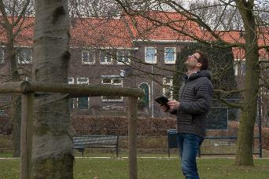
GIS for Arborists
Yves Martens
MSc. Geographic Information Systems
Mobile mapping and cartography
Training, workshops and courses
Trees and forests
Outdoor cooking

Slide 2
What are we going to do
What is GIS and why should you use it
Where to start
Different tools
Steps in any GIS project
Demo

Slide 3
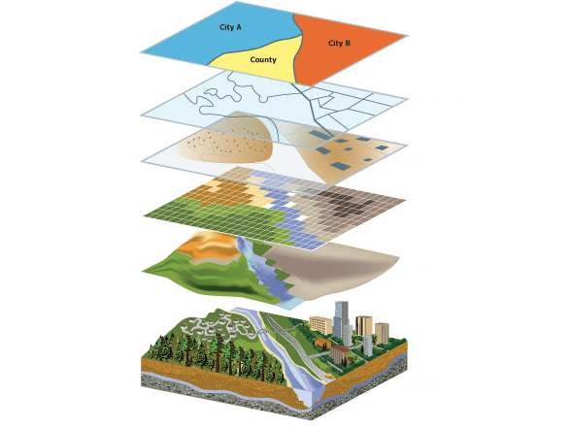
Source: Esri

Slide 4
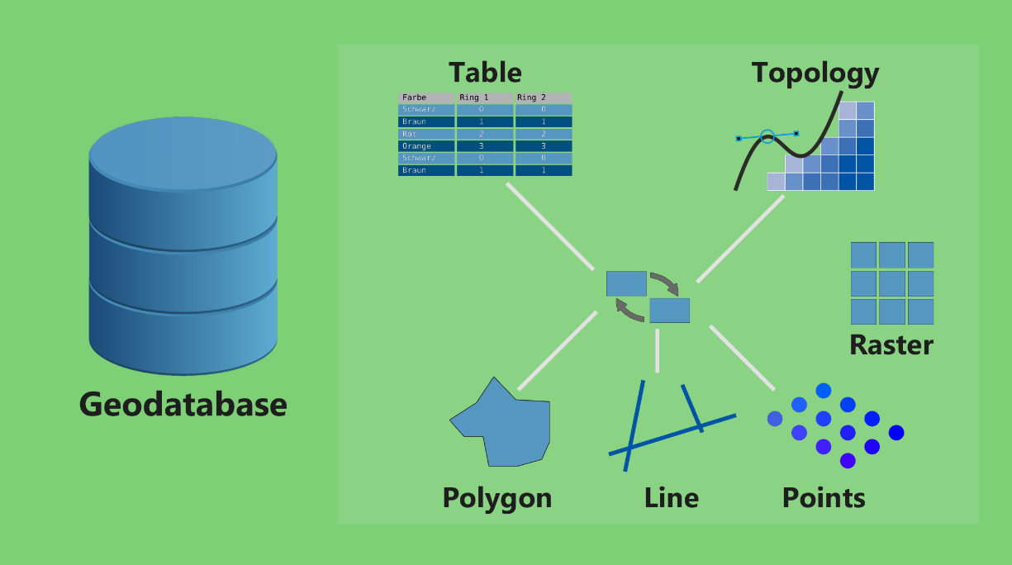

Slide 5
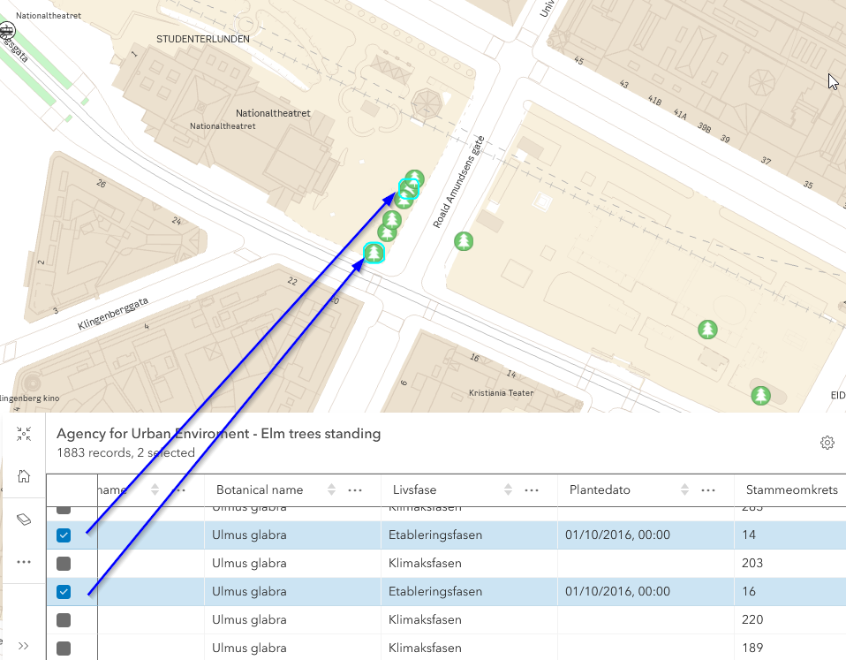

Slide 6
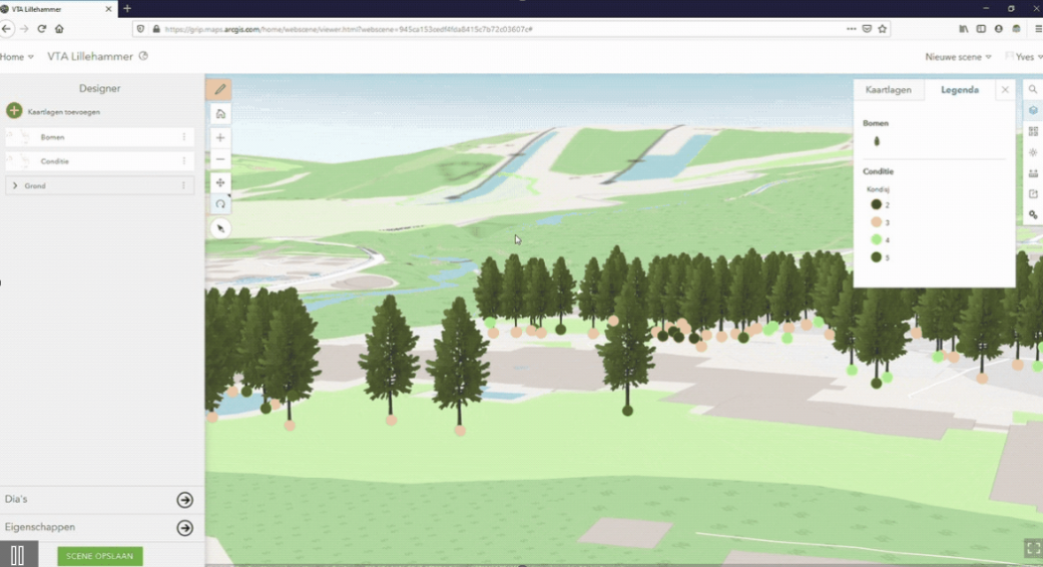
Visualize
Notes:
This is fun to watch but wait – the BIM!

Slide 7
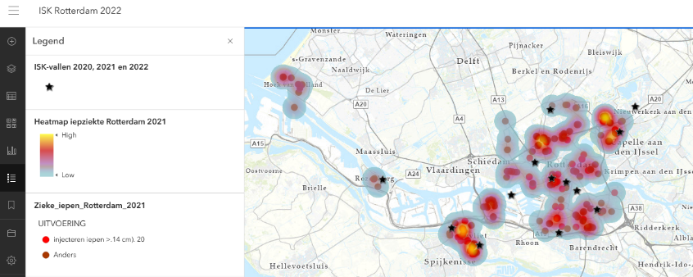
Analize

Slide 8
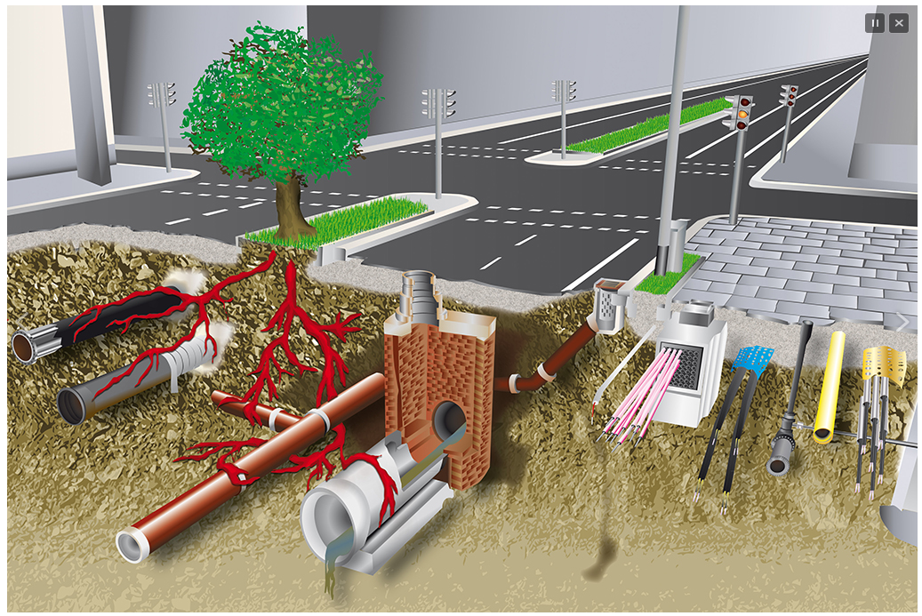
Manage

Slide 9
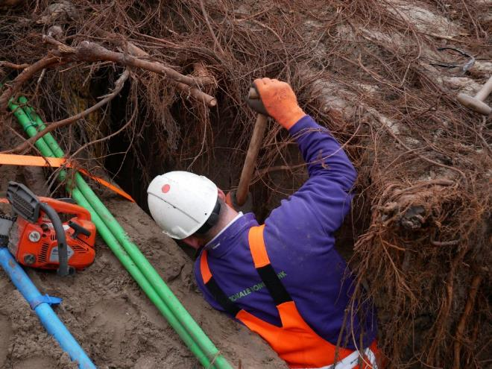
Protect

Slide 10
Where to start
Choose a mapping tool
Choose hardware
Learn how to work with it and Organize your data
Find your (survey and GIS-)partners
Keep developing your skills
Notes:
I come back soon on software and hardware
Organise your data, as it will built up fast
Find help
Keep learning

Slide 11
Different tools
Licensed of Commercial – eg. Esri
ArcGIS Desktop
ArcGIS Online icw Fieldmaps
Dedicated tree management software
Notes:
Lots of tools, I am not payed by any vendor and just use the tools that are most appropriate for me

Slide 12
Different tools
Open source – eg. QGIS
icw QFIELD or Mergin
Notes:
Lots of tools, I am not payed by any vendor and just use the tools that are most appropriate for me

Slide 13
Hardware
Windows or Apple for Desktop
Android tablet or iPad/iPhone for mobile
Rugged case
Notes:
Lots of tools, I am not payed by any vendor and just use the tools that are most appropriate for me

Slide 14
Organise your data
Using GIS generates data and files
Keep structure in your folders
Version management
Backup your data
Notes:
Lots of tools, I am not payed by any vendor and just use the tools that are most appropriate for me

Slide 15
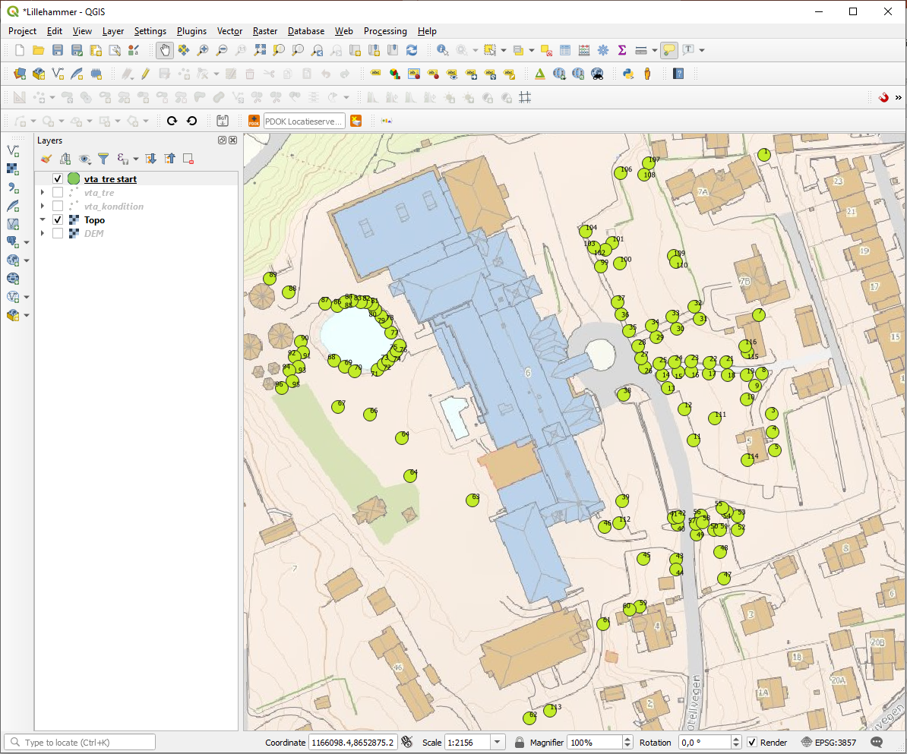
QGIS desktop – QFIELD mobile app
Prepare
Collect
Process
Analyze
Share
Source: Innlandet Trepleie
Notes:
The work flow is the same as in Esri

Slide 16
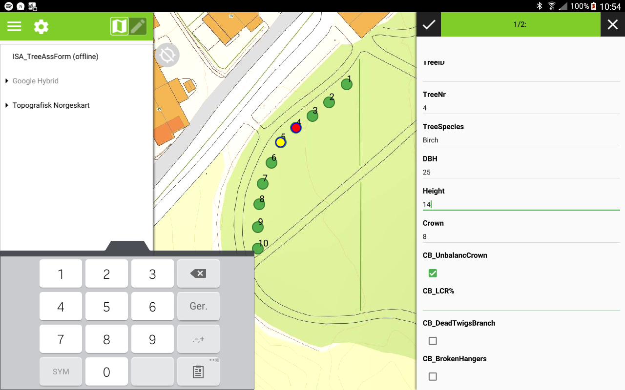
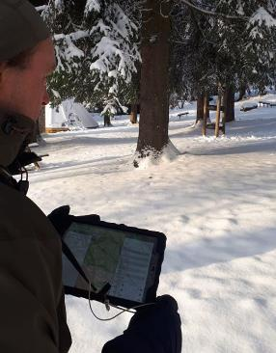
QGIS desktop – QFIELD mobile app
Prepare
Collect
Process
Analyze
Share
Notes:
The work flow is the same as in Esri

Slide 17
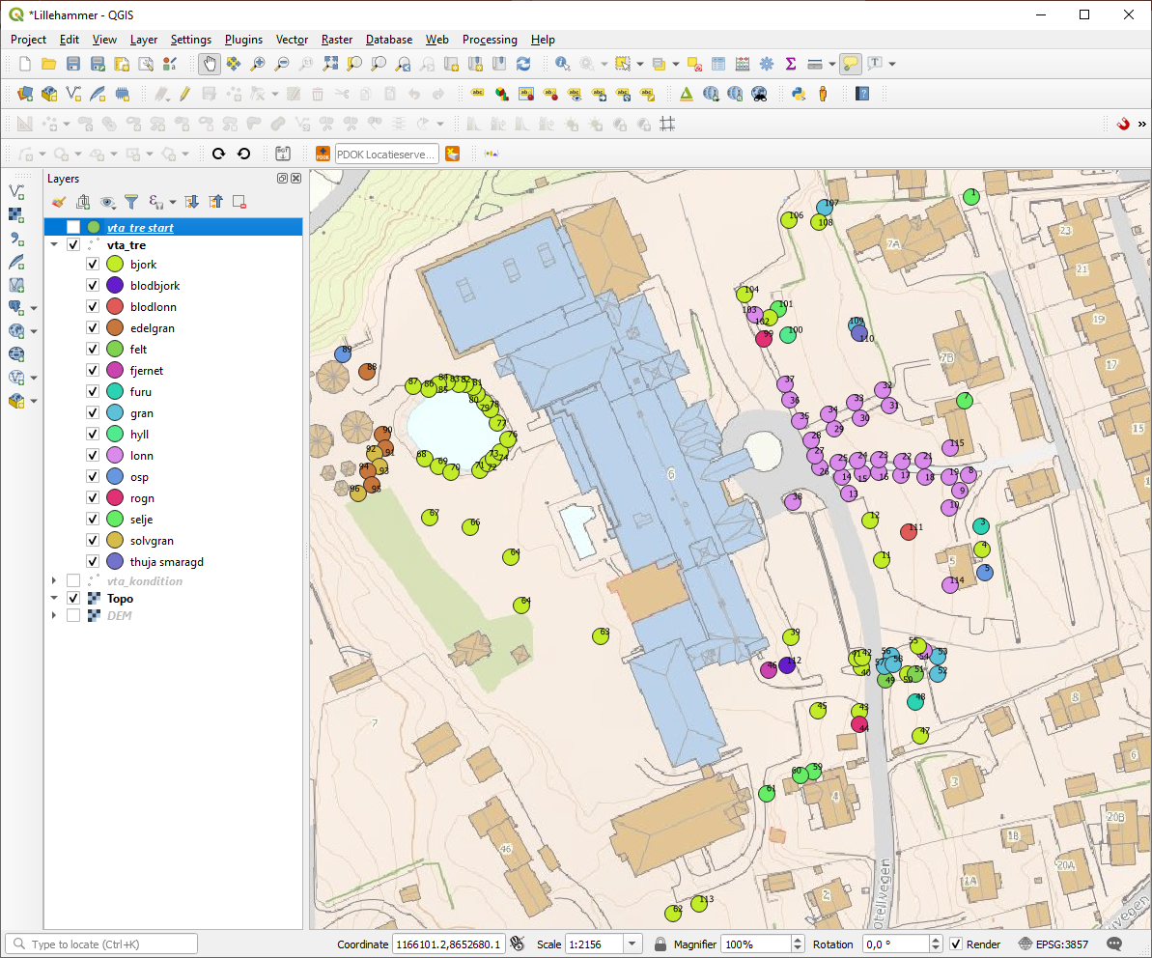
QGIS desktop – QFIELD mobile app
Prepare
Collect
Process
Analyze
Share
Source: Innlandet Trepleie
Notes:
The work flow is the same as in Esri

Slide 18
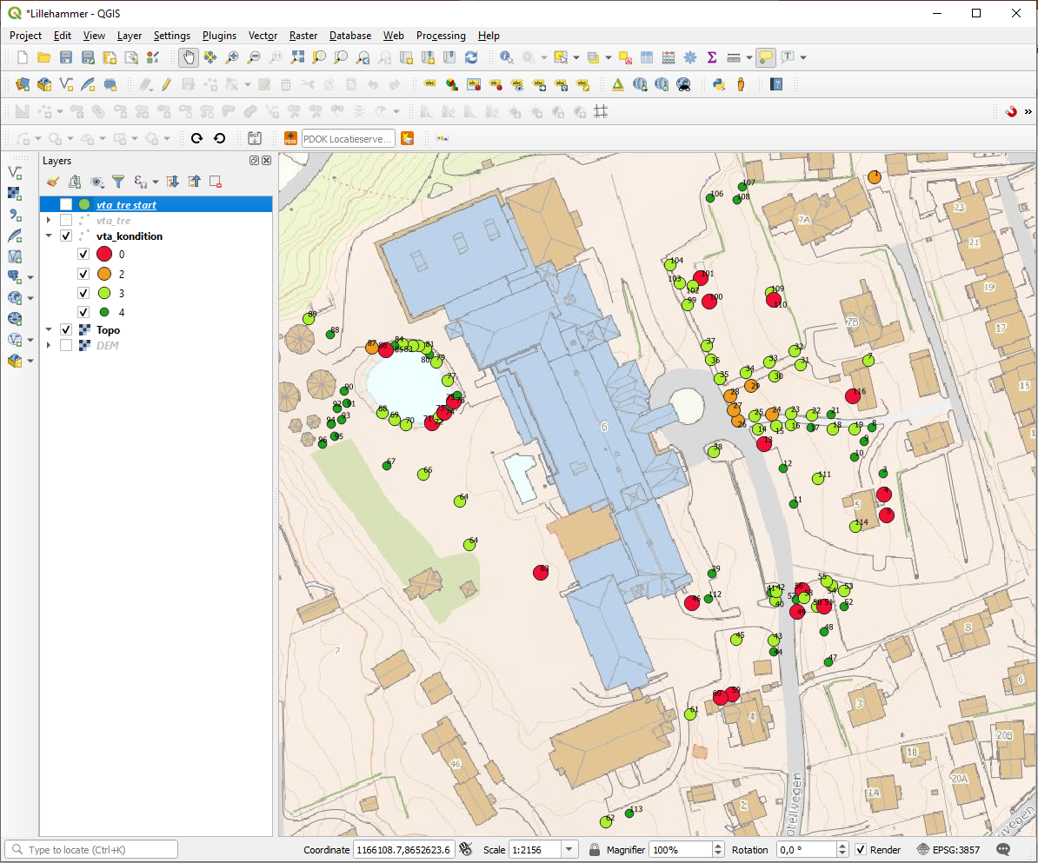
QGIS desktop – QFIELD mobile app
Prepare
Collect
Process
Analyze
Share
Source: Innlandet Trepleie
Notes:
The work flow is the same as in Esri

Slide 19
QGIS desktop – QFIELD mobile app
Prepare
Collect
Process
Analyze
Share
Source: Innlandet Trepleie
Notes:
The work flow is the same as in Esri

Slide 20
Knowledge base
Google
GIS Stack Exchange
Social media
Youtube
Qgis.org
Grip-op-gis.nl
Notes:
Discuss the pro’s and cons of open source, licences en stresses training and motivation to start using a new technique
Google is your best friend and don’t forget youtube and a educational institutes.

Slide 21
Demo QGIS & QFIELD

